Slide 1

Ample Armor for
Weak Warriors
6:14 – 20
Week 29
21 September 2022

Slide 2

Ephesians ch6 overview
In our last lesson (6:10-13), Paul described the spiritual battle that rages around Christians every day. He gave us verbal snapshots of our enemy and his forces of darkness.
Paul encouraged us to stand against the wiles of the devil by resting on God’s strength alone. And he used a powerful metaphor for God’s provision of protection and power for His saints—the “armor of God.”

Slide 3
Ephesians ch6 overview
This diabolical battle requires divine weapons and a satanic attack demands spiritual defenses. In 2Cor. 10:3-5, Paul refers to the potency of this God-given arsenal. These words are worth a careful reading:
“³For though we walk in the flesh, we do not war after the flesh: ⁴(For the weapons of our warfare are not carnal, but mighty through God to the pulling down of strong holds;) ⁵Casting down imaginations, and every high thing that exalts itself against the knowledge of God, and bringing into captivity every thought to the obedience of Christ.”
This passage powerfully describes the spiritual war in which we are engaged, whether we are aware of it or not.

Slide 4
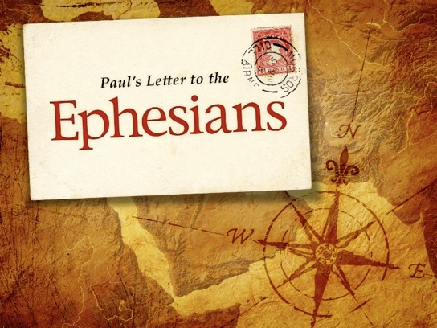
“Ample Armor for Weak Warriors”

Slide 5
Ephesians 6:14 – 20
If the 2 Corinthian 10:3-5 passage powerfully describes our spiritual warfare, then Paul’s poignant words in Romans 8:37-39 remind us of the guaranteed spiritual victory we have in Christ:
“³⁷Nay, in all these things we are more than conquerors through him that loved us. ³⁸For I am persuaded, that neither death, nor life, nor angels, nor principalities, nor powers, nor things present, nor things to come, ³⁹Nor height, nor depth, nor any other creature, shall be able to separate us from the love of God, which is in Christ Jesus our Lord.”

Slide 6
Ephesians 6:14 – 20
Because of the battle we’re in, and because God has given us “everything pertaining to life and godliness” in Christ (2Peter 1:3), Paul exhorts us to “take up the full armor of God” (6:13). So what, specifically, is the armor of God? Is it simply a general image of His divine protection?
Paul spends the next several verses detailing the specific elements of this armor that make up the believer’s spiritual articles of warfare, both defensive and offensive weapons. Then, as we are called to put on the whole armor of God, each of these items equips us in a uniquely different way.

Slide 7
Ephesians 6:14 – 20
Let’s try on each piece Paul presents and learn to utilize them all with precision and mastery. In 6:14-17, Paul describes the individual pieces of armor:
  the belt of truth
  the breastplate of righteousness
  the boots of peace
  the shield of faith
  the helmet of salvation
  the sword of the Spirit
Then, in 6:18-20, Paul shifts from the meaningful metaphors to a concrete exhortation that puts the armor to full use in spiritual warfare: Pray as if your spiritual life depends on it, because it does!

Slide 8
Ephesians 6:14 – 17
¹⁴Stand firm then, with the belt of truth buckled around your waist, with the breastplate of righteousness in place, ¹⁵and with your feet fitted with the readiness that comes from the gospel of peace. ¹⁶In addition to all this, take up the shield of faith, with which you can extinguish all the flaming arrows of the evil one. ¹⁷Take the helmet of salvation and the sword of the Spirit, which is the word of God.

Slide 9
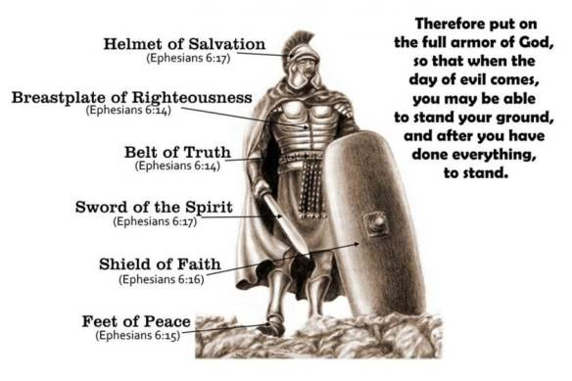

Slide 10
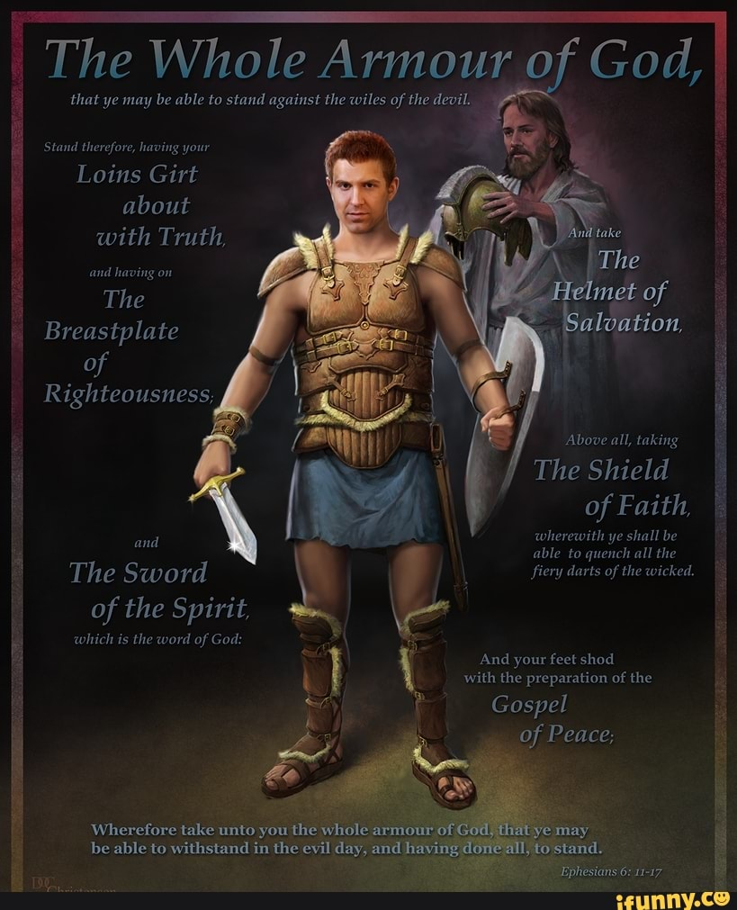

Slide 11
Ephesians 6:14 – 17
Before we briefly examine each item of spiritual armor, we need to remind ourselves once again that Paul is speaking metaphorically. He is using the image of a standard military uniform common in his day and combining this with his extensive knowledge of the Old Testament to paint an unforgettable picture of the specific means of protection granted by God to every believer.
The OT images Paul had in mind likely came from the book of Isaiah. Isaiah 11:5 mentions the Messiah coming with a belt of righteousness and faithfulness. Isaiah 59:17 refers to the Lord donning “righteousness like a breastplate” and putting “a helmet of salvation on His head.”

Slide 12
Ephesians 6:14 – 17
And Isaiah 52:7 describes the beauty of the feet of those who pronounce good news of happiness, salvation, and the kingdom of God. No wonder Paul calls these gifts bestowed upon God’s people by grace through faith “the armor of God.” Such armor calls for close inspection.
The belt of truth (6:14). Most of us today don’t “gird our loins,” do we? Today we buckle belts around our waists. The belt of a Roman soldier’s uniform, however, did more than hold his pants up or add a bit of stylish flare to otherwise outmoded attire. This heavy, six-inch-wide leather belt secured the soldier’s tunic so that the material wouldn’t hamper his movement.

Slide 13
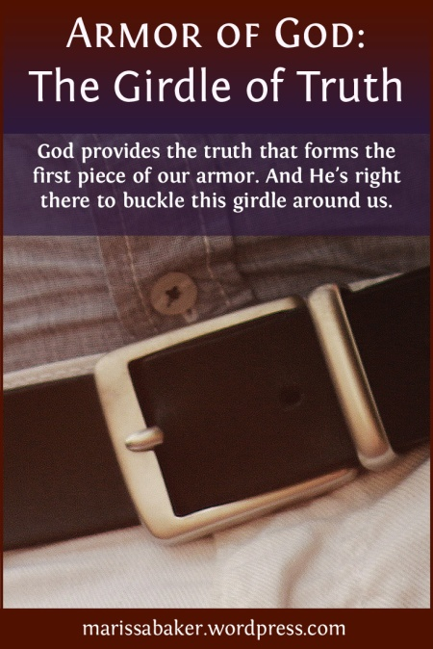
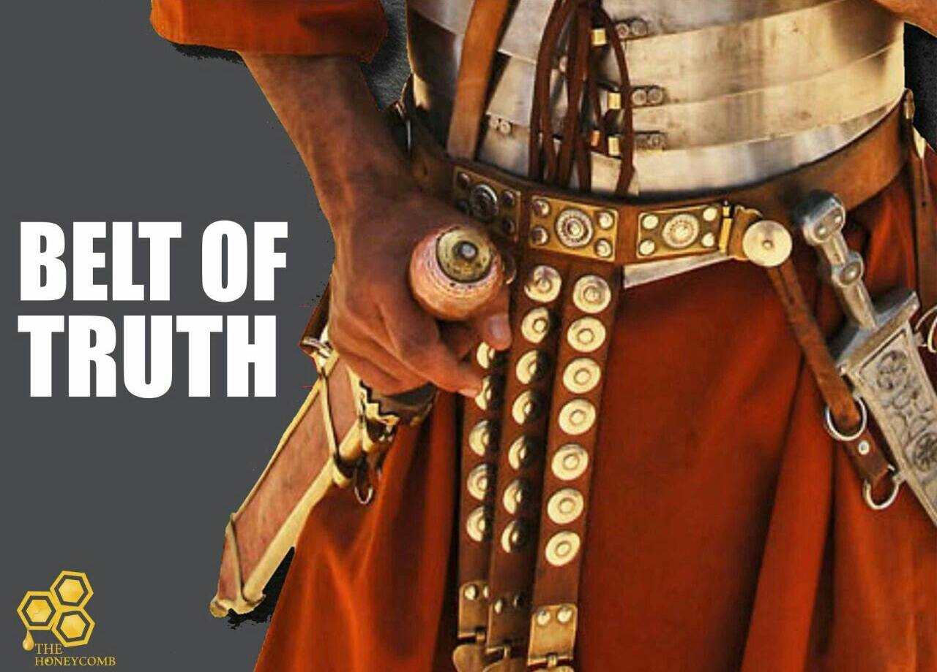
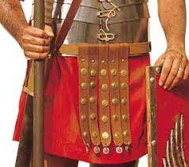
The Belt of Truth

Slide 14
Ephesians 6:14 – 17
It also helped hold in place his breastplate and the sheath for his weapon. The belt thus had the important function of keeping him free, protected, and agile enough to attack or defend, whichever the situation in battle required.
In Paul’s image, the belt is composed of truth—the truth of God, revealed in His written Word (John 17:17). It also includes truth of character, or integrity—practical living that conforms to the instruction of God’s Word (2John 1:4). In the heat of battle, when the flaming arrows of deception are flying around us and unjust accusations explode close enough to impact us, we need truth of doctrine and truth of character to keep us from falling apart.

Slide 15
Ephesians 6:14 – 17
This is why Paul urges us to keep that belt pulled tight: to keep the truth of God’s Word close to us, to keep His incarnate Truth—Jesus Himself (John 14:6)—at the center of our lives, and to maintain our strength with unquestioned integrity. As members of Christ’s army, we’re to stay true to what the Bible says is right. Doing so will keep us safe from countless dangers.
The breastplate of righteousness (6:14). The Roman breastplate was a large piece of leather, bronze, or chain mail that covered both the front and back of a soldier from his neck to his thighs. Its purpose? To protect the warrior’s vital organs—the core of his physical life, without which he would die in minutes.

Slide 16
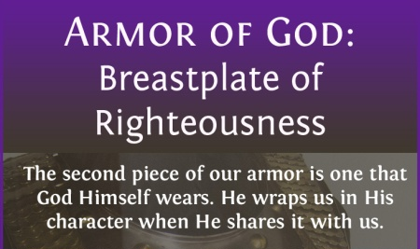
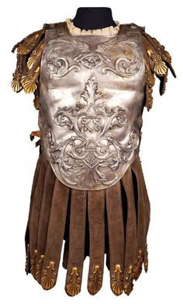
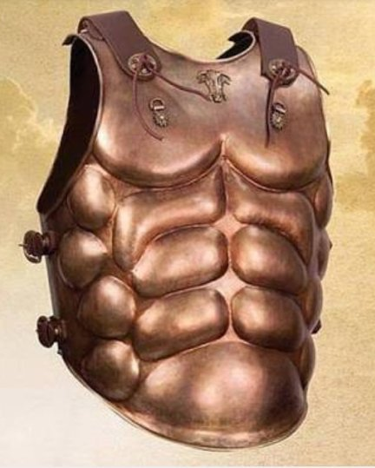
The Breastplate of Righteousness

Slide 17
Ephesians 6:14 – 17
As such, the breastplate was an essential piece of armor. No soldier would consider stepping into battle without it. For Paul, this was a perfect image of the righteousness that comes from God alone, righteousness we could never earn by our own merit or maintain in our own strength.
Paul describes this as “the righteousness of God through faith in Jesus Christ for all those who believe” (Rom. 3:22). Theologians call this righteousness “justification,” which is the sovereign act of God where by He declares righteous the believing sinner while he or she is still in a sinning state.
This is a declaration of innocence granted freely to believers the moment they are saved. Not based on good works but on Christ’s finished work on the cross, this positional righteousness can never be lost or taken away.

Slide 18
Ephesians 6:14 – 17
The Bible also describes practical righteousness that flows from our positional righteousness by the work of the Holy Spirit (Eph. 2:10; 5:9). Though these two must be distinguished—the righteousness by faith alone and the right living that is a result of faith—they are never meant to be separated. Authentic faith always leads to authenticating works (James 2:22, 26).
The breastplate of righteousness is as essential to us as the Roman soldier’s breastplate was to him. Our enemy, the accuser of believers loves to direct his arrows at the heart of our faith. He tries desperately to convince us that God can’t bridge the gap our sins have created. He hopes to plant seeds of doubt of God’s infinite grace.

Slide 19
Ephesians 6:14 – 17
Our accuser lobs missiles of guilt and shame and condemnation toward us, tempting us to believe that the love and forgiveness of God must be conditional. But when we stand firm in the knowledge that God has declared us righteous based solely on the blood of Christ and empowers us to live holy lives by the Holy Spirit alone, the devil and his wicked workers must retreat in defeat.
The boots of peace (6:15). I’m sure Paul had spent many long hours looking at his jailer’s boots, called “caligae.” The Roman legionaries wore heavy sandals with soles made of several layers of leather averaging ¾-inch thick, studded with hollow-headed hobnails. They were tied by leather thongs half-way up the shin and were stuffed with wool or fur in the cold weather.

Slide 20
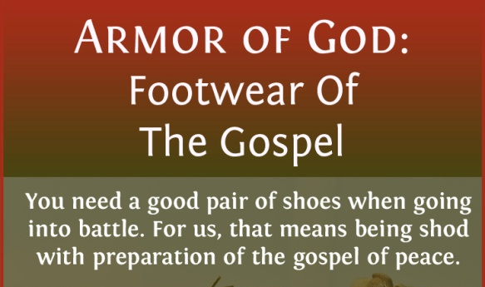
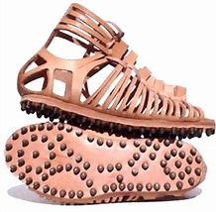
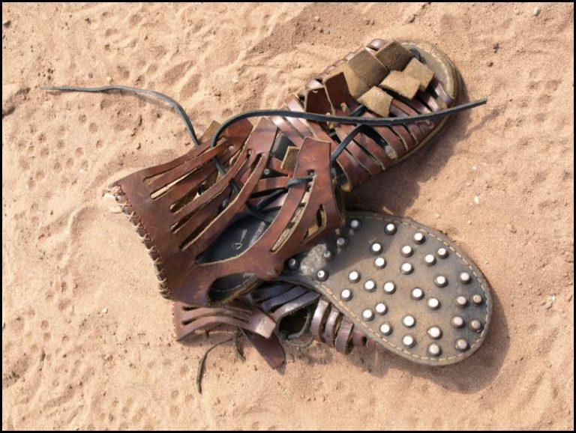
The Boots of Peace

Slide 21
Ephesians 6:14 – 17
These shoes were ideal for fast-moving hand-to-hand combat. Like today’s football and soccer cleats, they were meant to give maximum footing and traction to prevent sliding. They were designed to function in any terrain and were adaptable to any climate.
Our “footing” against Satan is our peace with God. Christ has secured this peace for us (Eph. 2)—peace not only with God but also with one another and within ourselves. As a result of this peace. Our Lord will never condemn us (Romans 8:1). Satan may pressure us all he wants, trying to convince us that God will reject and judge us when we falter. But if we know that our peace with God is secure, then we won’t slip and fall. We’ll stand stable and firm against the devil’s taunts.

Slide 22
Ephesians 6:14 – 17
Moreover, we’ll gain ground against his opposition so that we can spread the good news of peace with God through Christ to the troubled world around us.
The shield of faith (6:16). The shield Paul had in mind was the Roman “scutum,” a four-and-a-half-foot oval or rectangle of hide-covered wood framed with iron. Often the leather was soaked in water prior to battle in order to put out the enemy’s dangerous incendiary missiles—arrows dipped in pitch and set on fire. In battle this shield could be locked together with others to form a wall in front, and a roof overhead.
The barrage of “flaming arrows of the evil one” we experience in the Christian life can take many forms . . .

Slide 23
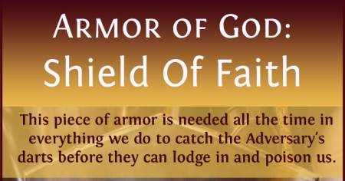
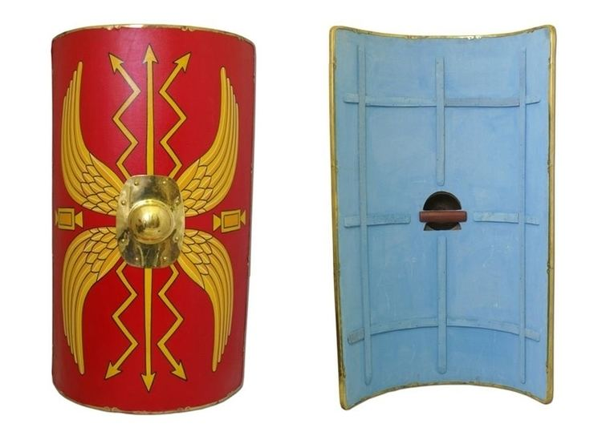
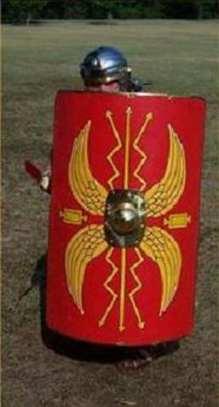
The Shield of Faith

Slide 24
Ephesians 6:14 – 17
Let’s name a few: temptation, doubt, anger, frustration, pride, despair, fear, guilt, shame, confusion, deception, discouragement, depression, hopelessness, greed, lust, presumption, stubbornness, laziness, suspicion, jealousy, hate, wrath, discord . . . the list continues on and on. In short, the kinds of fiery attacks at the devil’s fingertips are virtually innumerable. The shield of faith, however, provides an impenetrable protection from these things.
Through faith we see our circumstances from God’s perspective. We trust in Him to carry us through all trials and temptations. We stand firm and resolute, confident that our almighty Commander-in-Chief will see us through. In the midst of Satan’s rain of fire, we can take up the shield of faith as we pray . . .

Slide 25
Ephesians 6:14 – 17
As Swindoll prayed, “Lord, I trust You today in spite of these attacks. I trust You even though these things are coming my way. In spite of my nature, regardless of the habits I have formed, today, Lord, I walk in trust with You, and I use the shield of trust to repel all those arrows.
I pray that You will start early this morning in protecting me with this shield, because I can’t protect myself. I need Your shield and I trust You, Father, when I’m afraid. I trust You when it gets dark, I trust You when I’m in a situation that tempts me to the core. I trust You to guard my tongue, my eyes, my hands, my feet, my mind, my heart, and my soul.”

Slide 26
Ephesians 6:14 – 17
The helmet of salvation (6:17). In the first century, Roman soldiers’ helmets were made of bronze fitted over an iron skull cap lined with leather or cloth By Paul’s day, they often had a band to protect the forehead and plates to protect the nose and cheeks. Little of the head was exposed to danger, but a soldier could still see clearly so as not to be caught off guard by swift-moving enemies or unexpected objects.
The Christian’s helmet is salvation. When Paul tells his readers to “take the helmet of salvation,” he’s referring to one of the last actions of a soldier about to engage in battle, that is, slipping on his helmet and grabbing his sword. But this doesn’t imply that the believer’s salvation comes last.

Slide 27
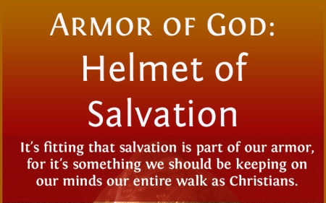
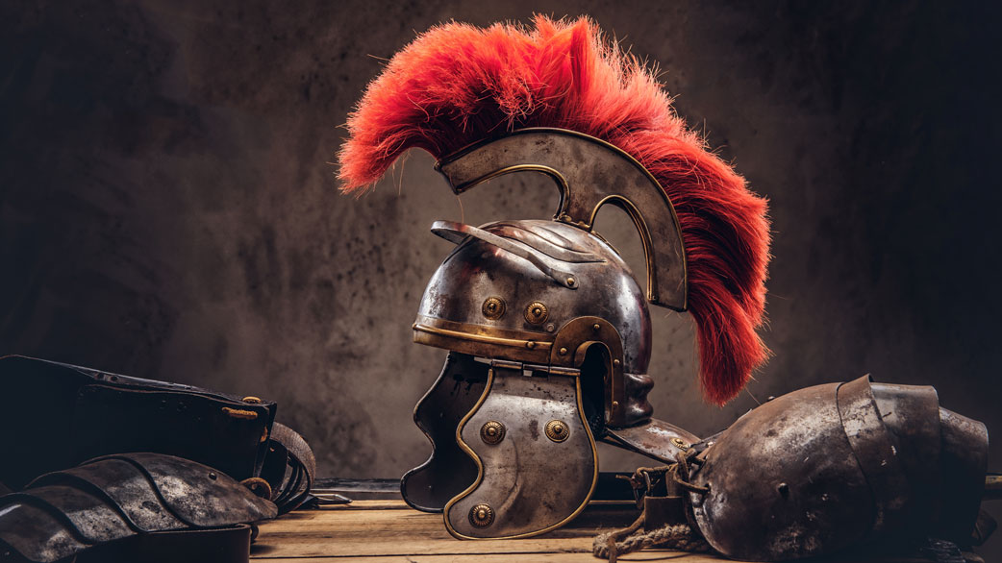
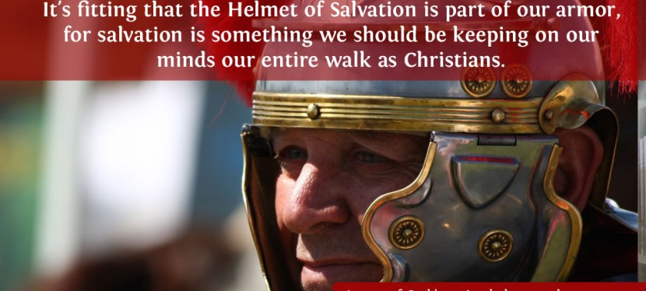
The Helmet of Salvation

Slide 28
Ephesians 6:14 – 17
Consequently, we don’t earn salvation only after putting on truth, righteousness, peace, and faith. Rather, all of these things come to us the instant we are saved by grace through faith. We need to have assurance of our position with Christ.
Why? Because Satan would like nothing better than to aim his arrows at our minds, convincing us that we don’t really belong to Christ, that we aren’t eternally saved. Satan would love to rob us of the hope of our resurrection, our glorification, and our eternal home in heaven.
It’s painful to hear of Christians who struggle with the “blessed assurance” of their salvation. Too many believers wonder if they believe the right things – in the right way – and with the right amount of conviction.

Slide 29
Ephesians 6:14 – 17
Or they wonder if they should have prayed a certain kind of prayer, gone forward at a certain meeting, or met some other traditional qualification. Or they struggle with assurance because they see imperfection in their lives and can’t seem to break free from certain temptations.
What a tragedy! We’re saved by God’s sovereign grace alone, through our simple faith alone, in the person and work of Jesus Christ alone. Don’t dissect your faith, either overly intellectualizing or overly psychologizing it.
Don’t try to add conditions to your salvation like an altar call, a raised hand, water baptism, a public confession of sins, or other things that may accompany or follow saving faith but are not replacements for it.

Slide 30
Ephesians 6:14 – 17
Keep short accounts before God with regard to sin . . . But don’t let your imperfection in this life rob you of your assurance. The more you look into your own heart, the worse it will appear. Instead, stay focused on Christ’s saving work on the cross. Look to Scripture’s promises of eternal, irrevocable salvation (John 10:28).
The assurance of your salvation is one of the most strategic parts of your equipment. Take it! You are saved. You came to Christ. You will never be unsaved. You never need to lack assurance. The assurance that came when you were born again is still yours to claim today.
One of Satan’s favorite tactics is to weaken your confidence in your eternal security. You have the helmet of salvation. Paul says, “Wear it!”

Slide 31
Ephesians 6:14 – 17
The sword of the Spirit (6:17). You may have noticed that so far all of God’s armor for spiritual warfare has been defensive in nature. The final article God has provided, however, is offensive: “the sword of the Spirit, which is the word of God.” The sword Paul referred to was the Roman “machaira,” a short sword used in hand-to-hand combat. Its two-sided blade was light and razor sharp. It was a highly effective weapon in the Roman army’s arsenal.
The Christian’s sword is the Word of God. However, the word translated is “rhema,” referring to the spoken Word– the Word verbalized. The word “rhema” has some overlap with the word “logos,” which means message or word. The focus of logos is the content of the message, while the focus of rhema is the expression of that message.

Slide 32
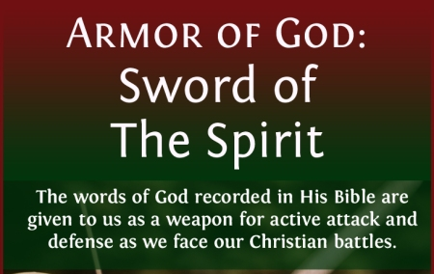
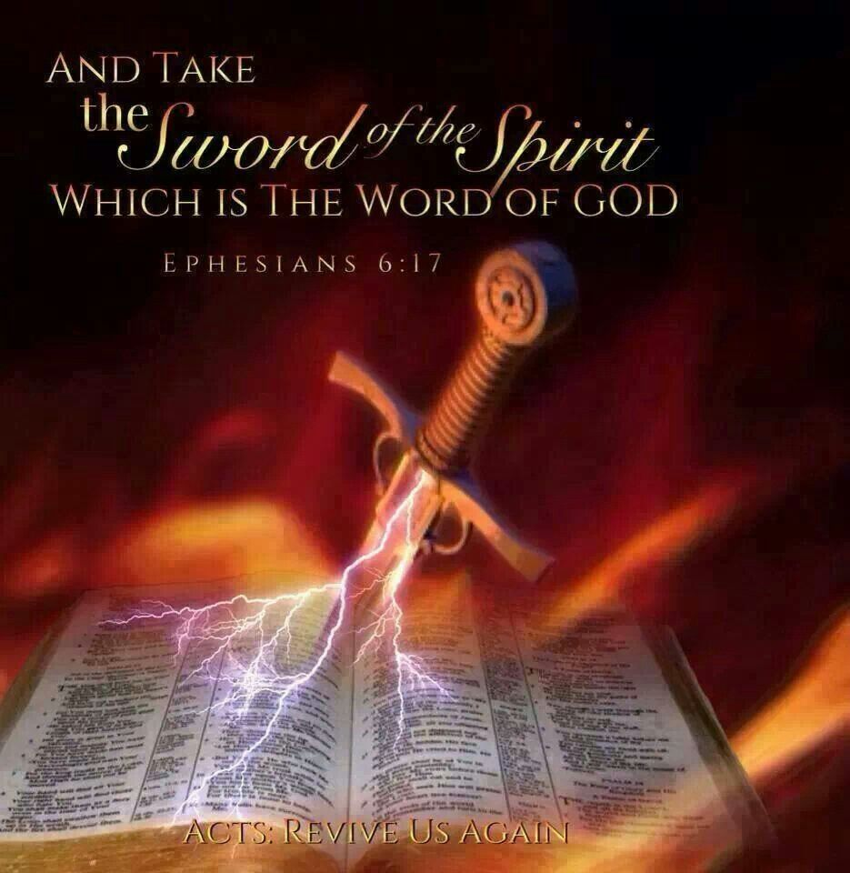
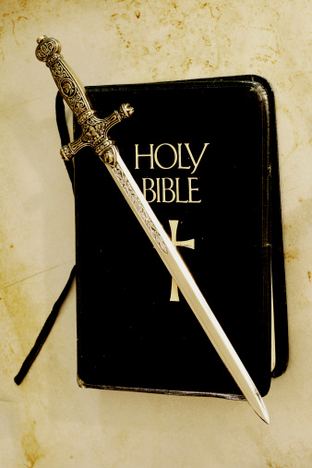
The Sword of Spirit

Slide 33
Ephesians 6:14 – 17
Paul’s emphasis here is not simply reading Scripture but actually using God’s revealed Word against Satan and his insidious spirits of darkness. That’s what Jesus did when He was tempted by Satan in the wilderness of Judea.
After Jesus fasted forty days and forty nights, the devil tempted Him to turn some stones into bread to eat. Jesus quoted Deuteronomy 8:3, saying, “Man shall not live on bread alone, but on every word (rhema) that proceeds out of the mouth of God” (Matt. 4:4).
It’s no wonder, then, that Paul likens the spoken Word of God to a sharp sword. Just like an earthly sword, the sword of the Spirit is not something we can pick up as novices and immediately wield like pros.

Slide 34
Ephesians 6:14 – 17
Rather, it takes many years to grow in the Word of God, sharpening our skills, enhancing our knowledge, and applying it to our lives.
Then, with God’s Word in our heads through memorization, in our hearts through meditation, and in our hands through application, we have the power to effect change by speaking, sharing, and living out that Word.

Slide 35
Ephesians 6:18 – 20
¹⁸And pray in the Spirit on all occasions with all kinds of prayers and requests. With this in mind, be alert and always keep on praying for all the Lord’s people. ¹⁹Pray also for me, that whenever I speak, words may be given me so that I will fearlessly make known the mystery of the gospel, ²⁰for which I am an ambassador in chains. Pray that I may declare it fearlessly, as I should.

Slide 36
Ephesians 6:18 – 20
Finally, Paul adds one last element to the Christian’s battle strategy. This tactic reminds us that we do battle in God’s strength, not our own. In 6:14-17, Paul described the pieces of armor given to us by God—each piece dependent on the others, all of them essential to win a victory over the wiles of the devil.
Now, in 6:18-20, Paul turns our attention to our practical response. Having suited up for battle, what do we do now? Stand around and wait? Crouch in a corner, ready to pounce? Paul’s exhortation is actually much simpler and more effective. We are to pray, making constant petitions with perseverance (6:18). Above all else, prayer expresses our reliance on God.

Slide 37
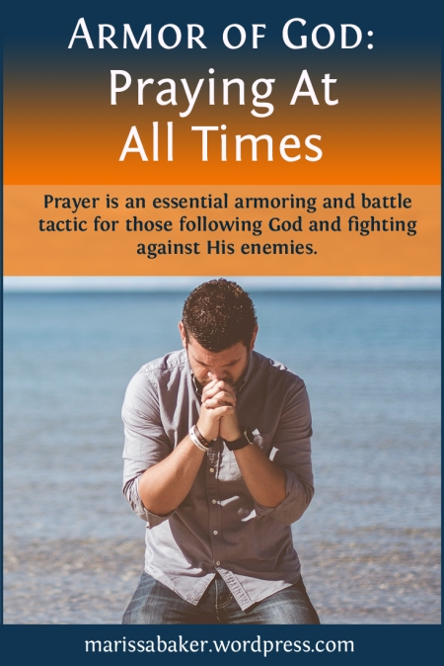
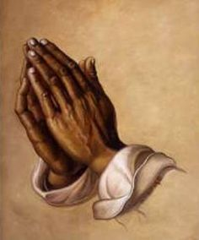
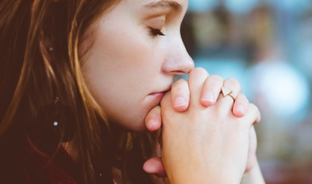
Praying in the Spirit

Slide 38
Ephesians 6:18 – 20
Our enemy, Satan, studies our weaknesses and plots his attacks accordingly. We need to be just as precise in the requests we take to the Father on behalf of our fellow soldiers in Christ. We bring before Him “all prayer and petition” (6:18). But even at this point, when we are doing battle against the forces of wickedness on our knees, don’t believe for one second that it’s all on our shoulders.
Rather, in our pleas to God, the Spirit Himself comes to our aid. To pray “in the Spirit” means to pray by His power, according to His ability, not ours, and in accordance with His will. In Romans 8:26, Paul wrote > “In the same way the Spirit also helps our weakness; for we do not know how to pray as we should, but the Spirit Himself intercedes for us with groanings too deep for words.”

Slide 39
Ephesians 6:18 – 20
As we pray, we must “be on the alert” (6:18), having our hearts trained to detect oncoming assaults from the enemy. No matter what, we must keep on praying, never becoming discouraged if victory takes longer than we expected. Remember, too, that we’re all targets of the same brutal, relentless force of wickedness, so we must continually lift each other up in prayer.
This is why Paul urges us to pray “for all the saints” –from the least to the greatest, from the baby Christian still stumbling over the tiny obstacles Satan tosses in his path to the mature missionary trudging through spiritual jungles as Satan attempts to derail her life long endeavors. From first to last, the battle cry of the Christians is “Pray!”

Slide 40
Ephesians 6:18 – 20
Even the apostle Paul acknowledged his desperate need for prayer support. In 6:19, he asked for prayer that God would give him supernatural ability to proclaim the gospel with boldness. We usually assume that Paul was fearless, impervious to discouragement, and unstoppable in the pursuit of his calling to preach wherever, whenever, and to whomever.
But Paul was a frail, fallen human being like the rest of us. And remember, he was under house arrest, “an ambassador in chains” (6:20), the victim of the frustrating effects of Satan’s warfare against the saints.

Slide 41
Ephesians 6:18 – 20
Paul needed prayer from his fellow believers, fearing that the mystery of the gospel might get stuck in his throat, muffled by apprehension about what might happen to him or his loved ones if he spoke with too much zeal.
Paul was human, just like you and me. Yet he was humble and honest enough to admit his need and to ask for help both from God, his Defender, and from the people of God, his support. Are you willing to do the same?

Slide 42
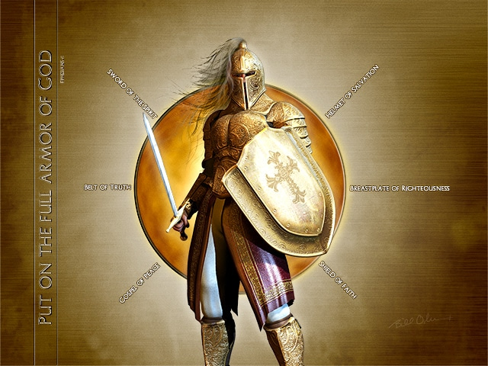

Slide 43



Slide 44
NEXT CLASS – 28 September 2022
Book of Ephesians
Before next class, read the below verses in the NIV and in one other versions of the Bible, i.e., NKJV, NRSV, KJV, CEV, etc …
Chapter 6:21 – 24
“Wrapping Up Well”

